Slide 1
Analysis Lab 4
Hypothesis Testing

Slide 2
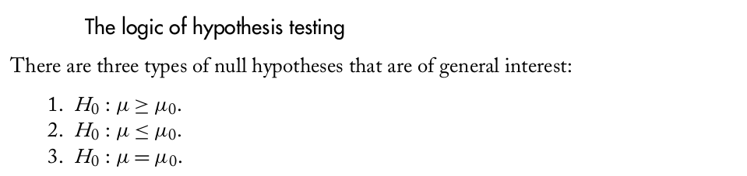
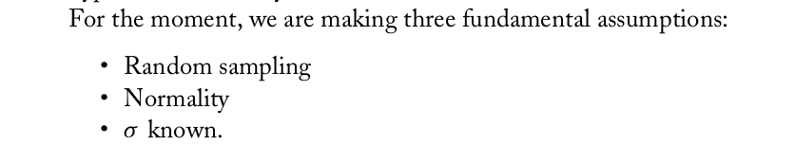
Analysis Lab 4
Hypothesis Testing
Source: BASIC STATISTICS. Understanding Conventional Methods
and Modern Insights. Rand R. Wilcox. Oxford University Press (2009).

Slide 3
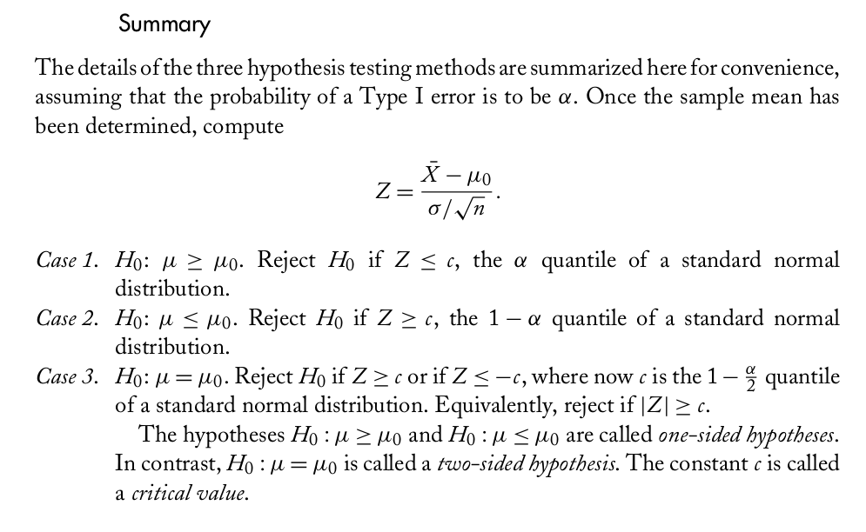
Analysis Lab 4
Hypothesis Testing
Source: BASIC STATISTICS. Understanding Conventional Methods
and Modern Insights. Rand R. Wilcox. Oxford University Press (2009).

Slide 4
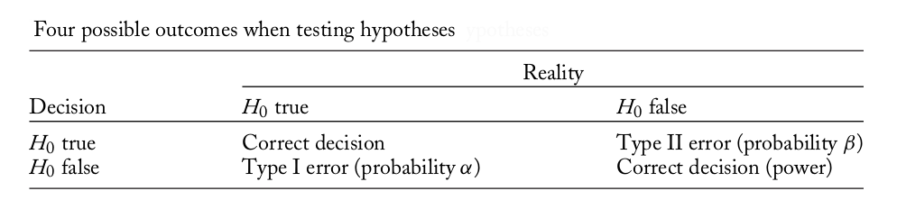
Analysis Lab 4
Hypothesis Testing

Slide 5
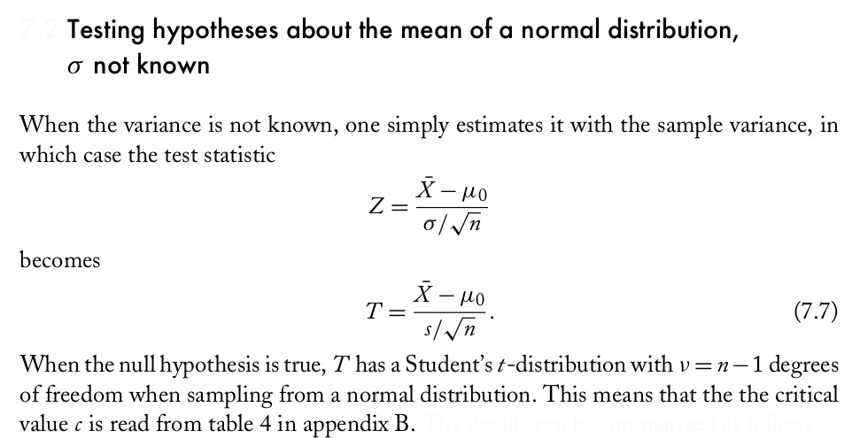
Analysis Lab 4
Hypothesis Testing
Source: BASIC STATISTICS. Understanding Conventional Methods
and Modern Insights. Rand R. Wilcox. Oxford University Press (2009).

Slide 6
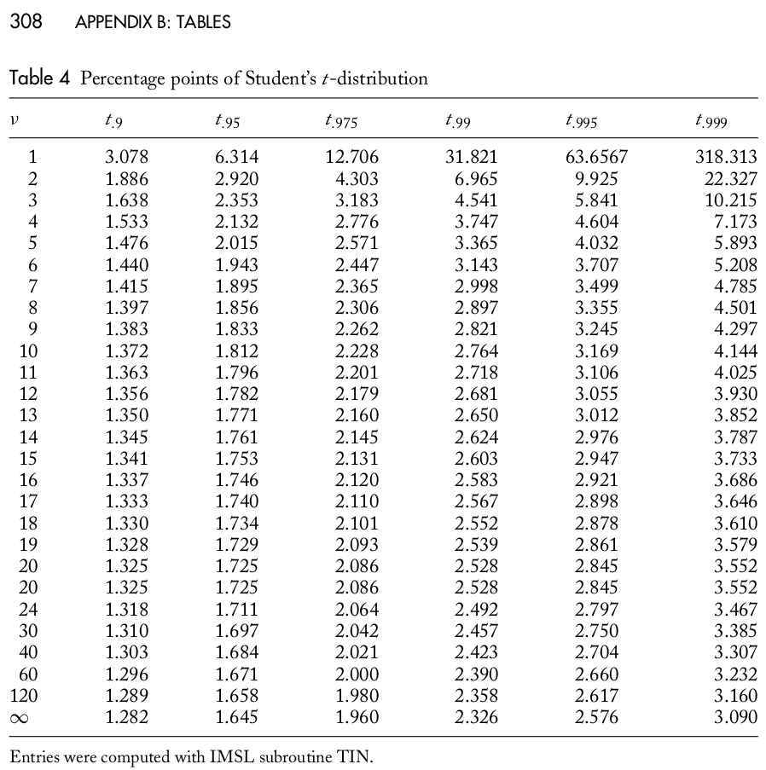
Analysis Lab 4
Hypothesis Testing
Source: BASIC STATISTICS. Understanding Conventional Methods
and Modern Insights. Rand R. Wilcox. Oxford University Press (2009).

Slide 7
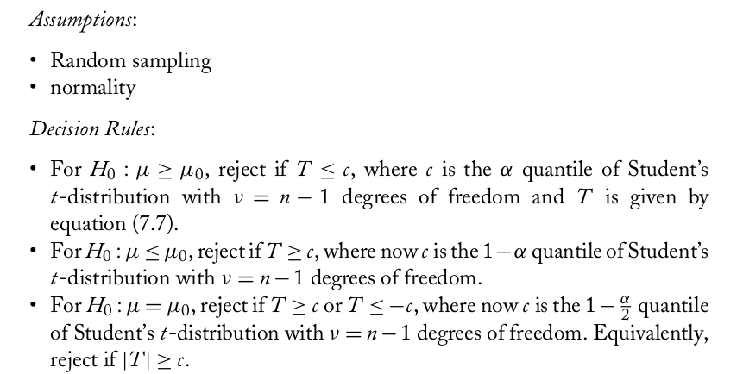
Analysis Lab 4
Hypothesis Testing
Details can be summarized as follows:
Source: BASIC STATISTICS. Understanding Conventional Methods
and Modern Insights. Rand R. Wilcox. Oxford University Press (2009).

Slide 8
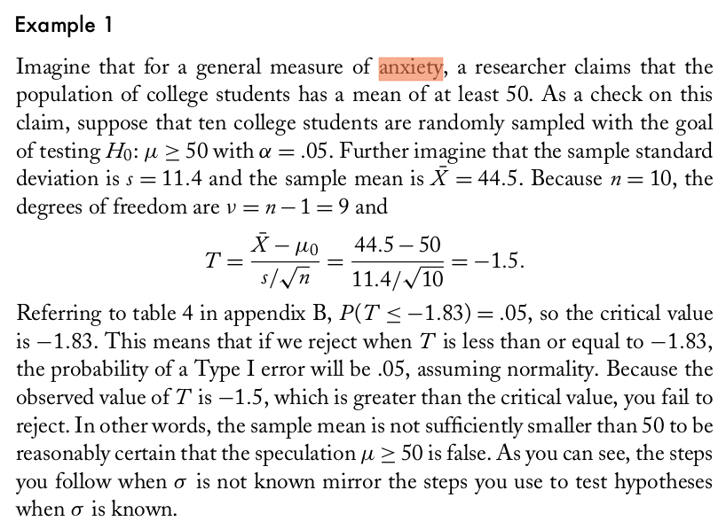
Analysis Lab 4
Hypothesis Testing
Example
Source: BASIC STATISTICS. Understanding Conventional Methods
and Modern Insights. Rand R. Wilcox. Oxford University Press (2009).

Slide 9
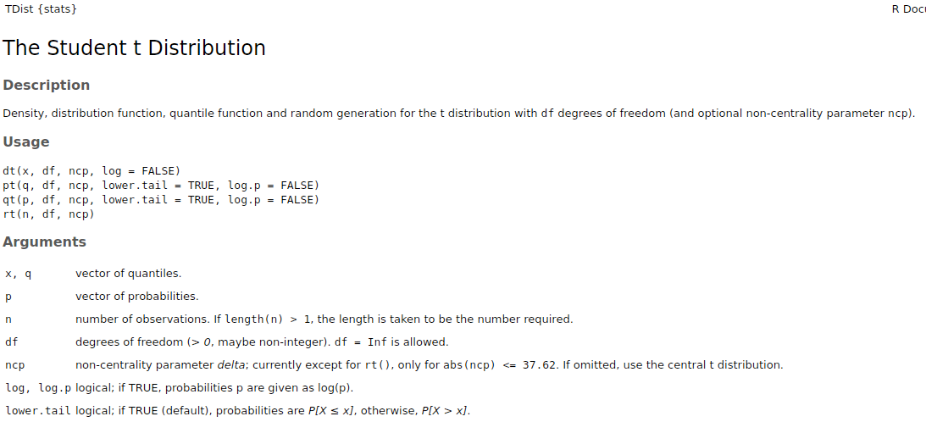
Obtaining critical values with R
Example
> qt(p=0.05, df=9, lower.tail = TRUE, log.p = FALSE)
[1] -1.833113
[In words: The quantile corresponding to a
(lower tail) 0.05 Probability with df = n-1 = 10-1
Degrees of freedom is -1.83]

